Slide 1
Deep Ocean Learning
of Small-Scale Turbulence
Machine Learning Approaches to Predicting Ocean Mixing
Based on Mashayek et al. (2022)

Slide 2
Introduction
ε: turbulent kinetic energy dissipation per unit mass
Essential for ocean modeling ocean mixing, heat/carbon transport, climate simulations
Problem: Measuring ε is costly (Microstructure Profilers), has not been done much in the past
CTD measurements are plentiful
Utilize NN/ML to predict ε out of CTD parameters
Predict turbulent diffusivity κ = Γε/N² from T, S, Z using machine learning
Notes:
K_ρ (kappa, turbulent diapycnal diffusivity) measures the effective vertical diffusion rate of density (neutral density surfaces) due to small-scale turbulence.

Slide 3
Literature Review
Finestructure parameterizations suffer from restrictive assumptions (±2 orders of magnitude error) (Polzin 2014)
Direct ε measurement requires microstructure sensors measuring ∂u'ᵢ/∂xⱼ strain rates
Cael & Mashayek (2021): Log-skew-normal universality in global turbulence distributions
Physics-informed ML: Combine observational data with nonlinear feature relationships
Physical constraint improves the generalization of NN-based parameterization simulation
using limited observations and well-understood physical constraints to construct a physics-informed deep-learning parameterization for improved climate

Slide 4
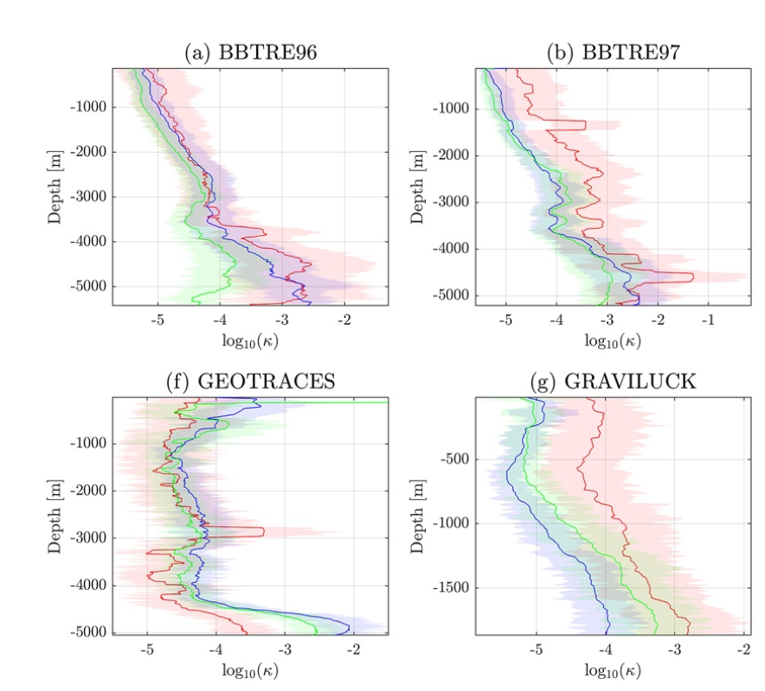
Cael & Mashayek (2021):
Literature Review-
Results

Slide 5
Cael & Mashayek (2021):
Literature Review-
Results
CART R² = 0.83 (ε), 0.84 (κ); NN R² ≥ 0.85 both targets
Feature importance: N² > Z/H > salinity gradients > latitude
Out-of-distribution validation: Models trained on 12/13 experiments, tested on withheld experiment
DIMES comparison: ML predictions superior to Sheen et al. (2013) finestructure estimates

Slide 6
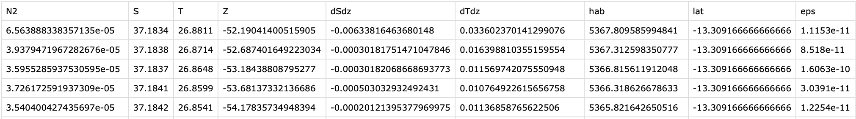
Geomar dataset
Dataset Characteristics & Preprocessing
Post-processing: ~ 0.7 m resolution
Feature engineering: log₁₀(N²), S, T, Z, ∂S/∂z, ∂T/∂z, hab (GEBCO), lat, ε;
Neutral density γₙ from UNESCO equation; H from Sandwell et al. bathymetry

Slide 7
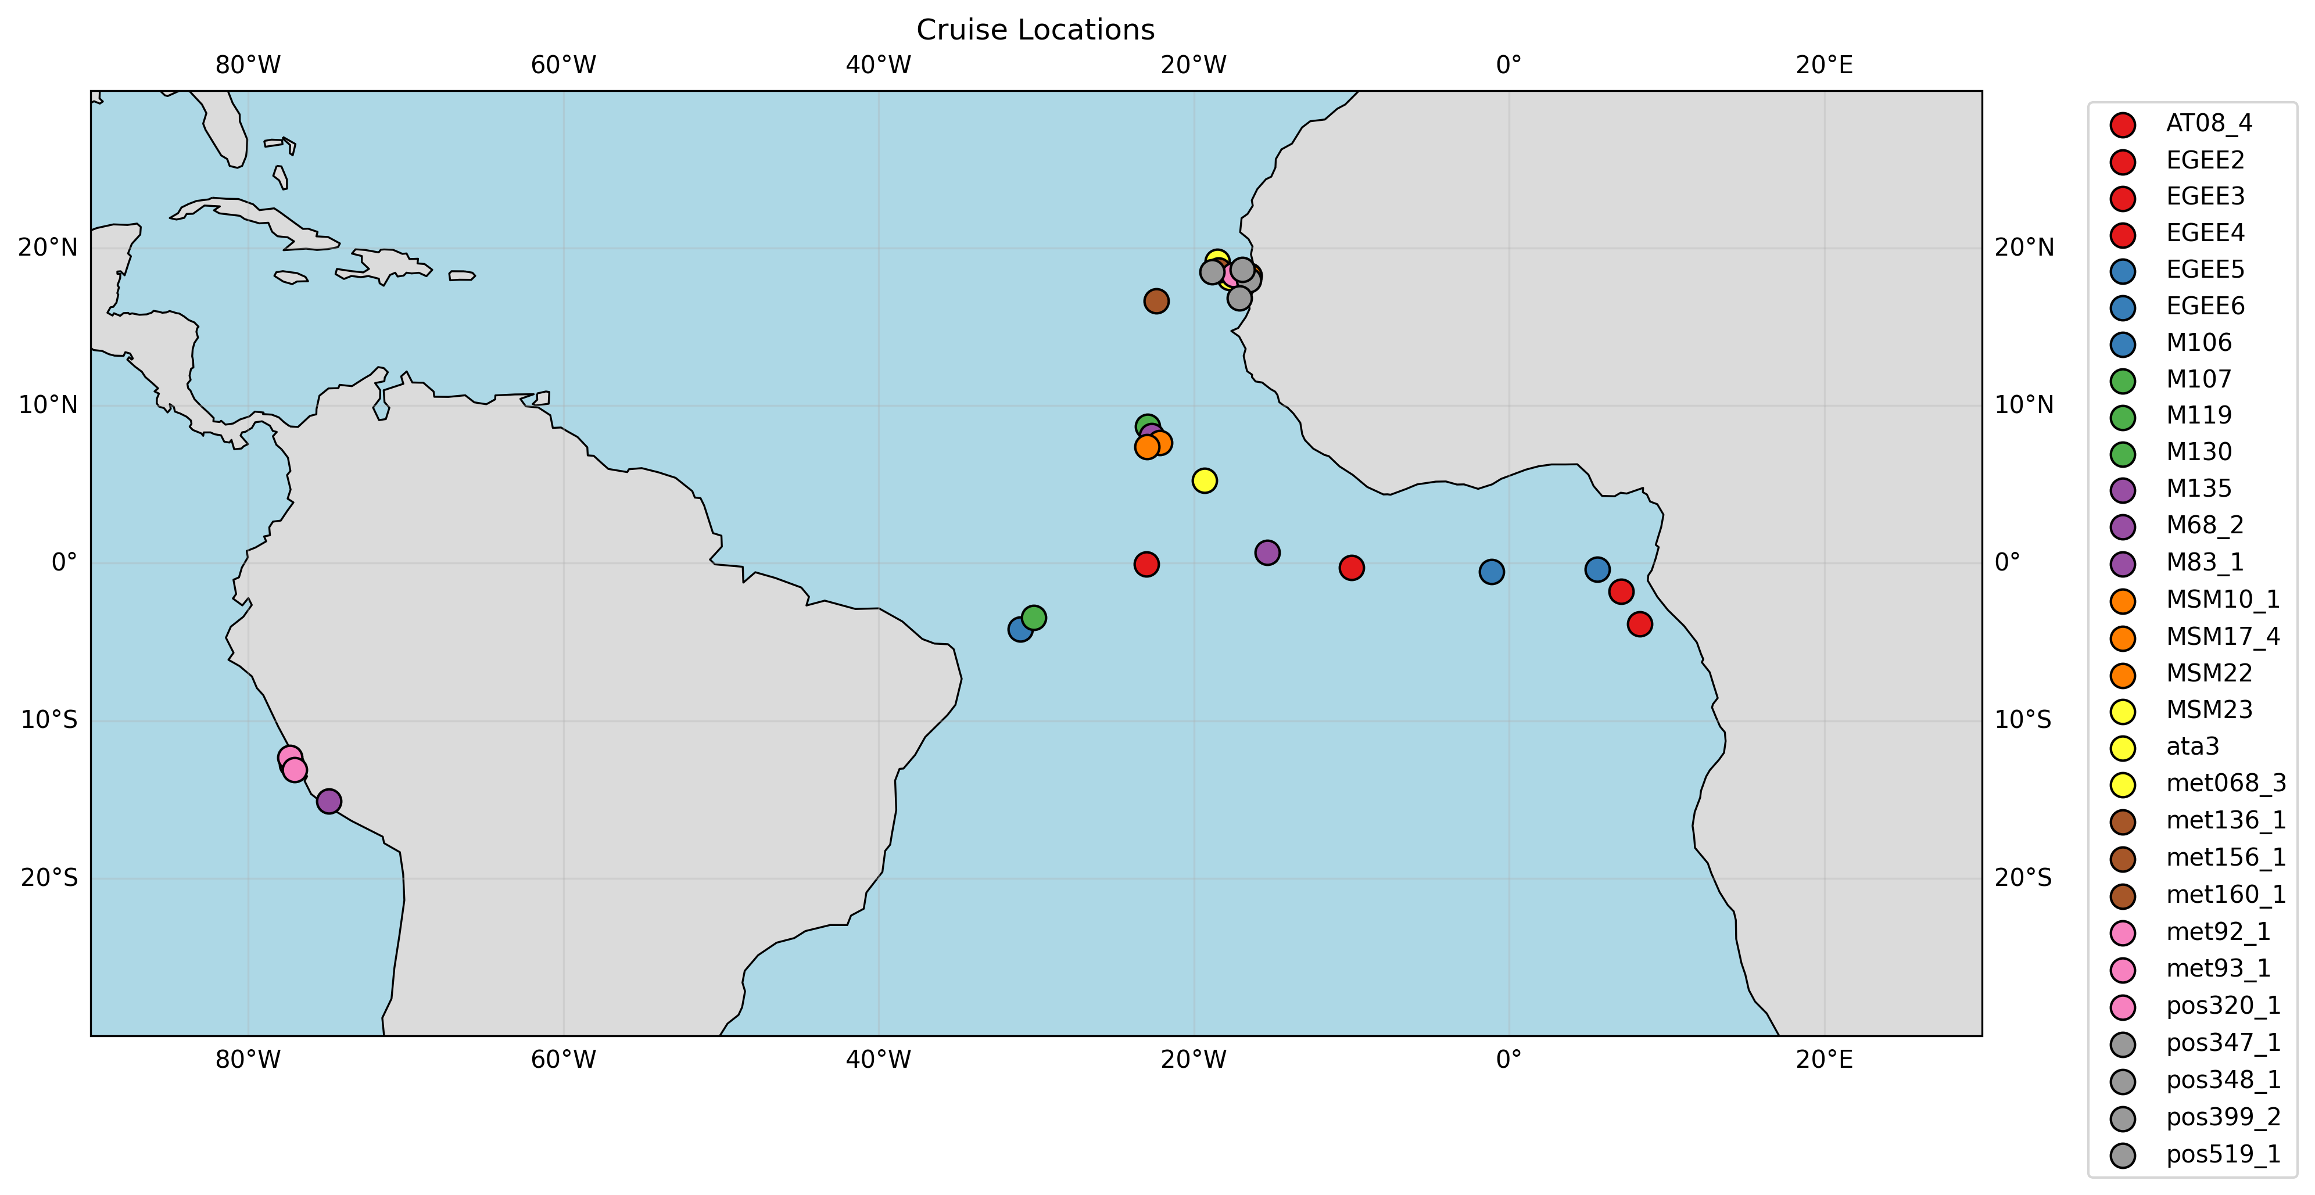
Dataset Characteristics & Preprocessing
GEOMAR microstructure dataset:
29 field experiments,
4021 full-depth profiles
8757401 Datapoints
1165844 Datapoints after Processing + Exclusion of Validation Profile

Slide 8
Model Definition & Evaluation
CART: Bootstrap aggregated regression trees (n_estimators=500)
ResNet-FNN: Skip connections + SGDR warm restarts regularization
Target variables: log₁₀(ε) -> log₁₀(κ)
Validation: 10-fold stratified cross-validation across all 29 experiments (Minus validation)

Slide 9
Training Parameters
cart = DecisionTreeRegressor
max_depth=8, # Max 8 levels → ~256 leaves max
min_samples_split=20, # Need ≥20 samples to split node
min_samples_leaf=10, # Each leaf ≥10 samples
random_state=seed # Reproducible splits
resmlp_10fold_with_cosine
numLayers=3 # 3 residual MLP blocks (skip connections)
nhidden=120 # 120 neurons per hidden layer
lr_max=3.5e-3 # Peak learning rate (SGDR restarts)
batch_size=1000 # Large batches → stable gradients
num_epochs=50 # Total epochs (multiple SGDR cycles)
zmin=-1062.0 # Depth normalization (Z → [0,1])

Slide 10
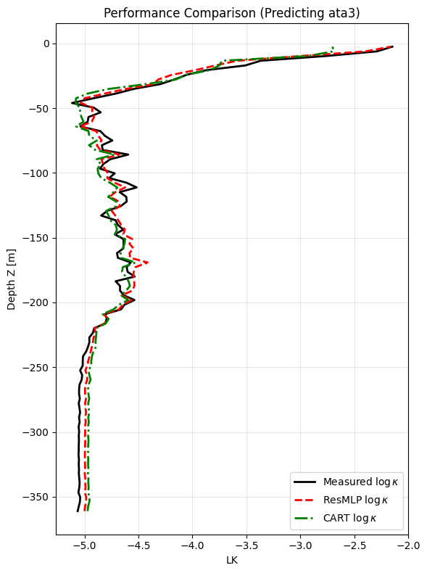
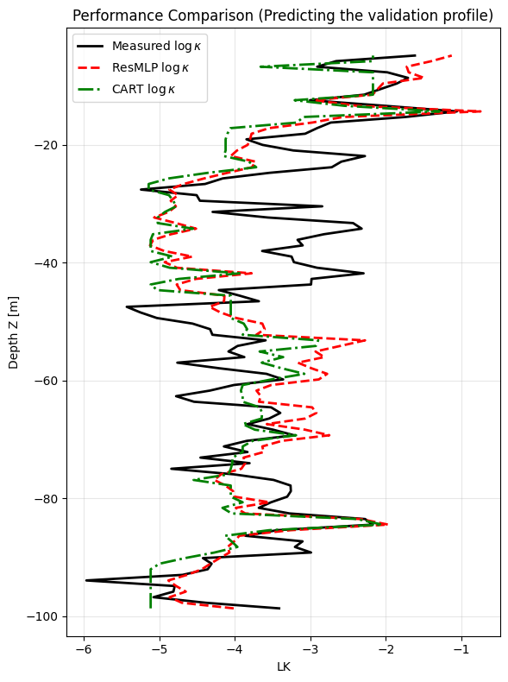
Preliminary Results

Slide 11
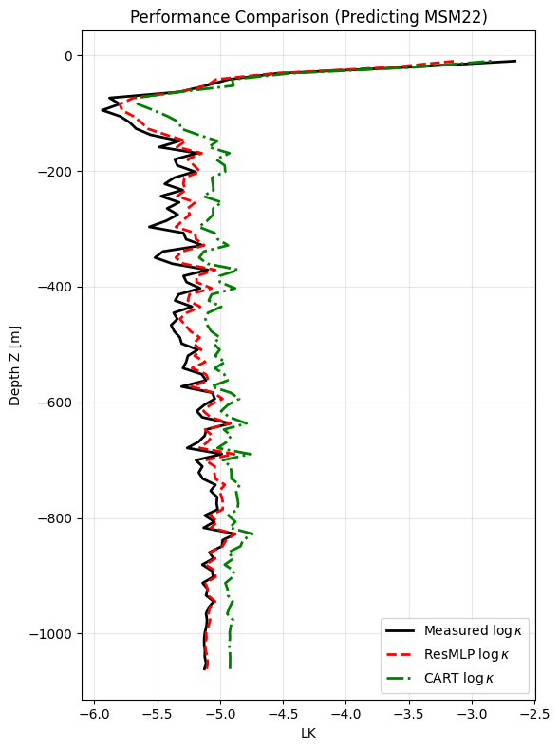
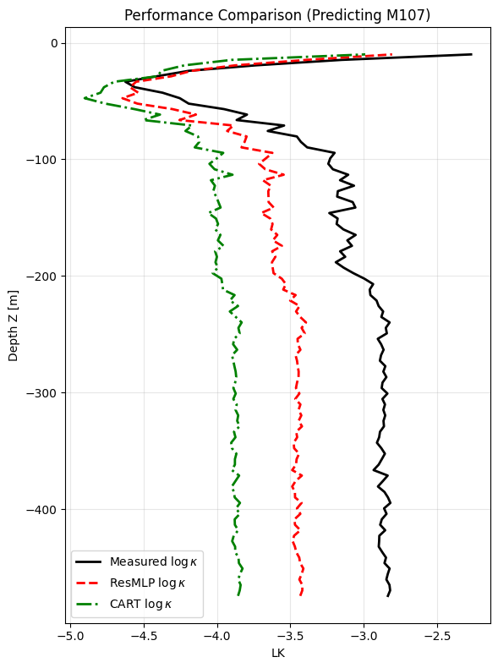
Preliminary Results

Slide 12
Comparison

Slide 13
Discussion
ML (CART-bagging, NNs) predicts ε → κ from T/S/Z/N²/hab/lat with skill
Regional variability: Performance differs by field program (data imbalance, physics)
Outperforms classical finestructure schemes, especially κ inference
Aligns Cael & Mashayek (2021) log-skew-normal ε universality
Conclusions
Physics-AI enables global interior mixing from hydrography + bathymetry
Minimal controls: stratification + boundaries (hab) + latitude → ε, κ to leading order
Data-driven universality confirms log-skew-normal dissipation statistics
Future Work
Harmonized global ε datasets (gliders, moorings) → better generalization
Non-local drivers: wind/tide energy input, internal waves
Vertical resolution sensitivity + physics-informed losses
Discussion, Conclusion & Future Work

Slide 14
References
Zhu, Y., Zhang, Z., Qian, Y., Li, X., & Wang, B. (2022). Physics-informed deep-learning parameterization of ocean vertical mixing improves climate simulations. Nature Communications, 13, 5706. https://doi.org/10.1038/s41467-022-33404-5
Cael, B. B., & Mashayek, A. (2021). Log-skew-normal universality in global turbulence distributions. Nature Geoscience, 14, 915–921. https://doi.org/10.1038/s41561-021-00854-9
Polzin, K. L. (2014). A heuristic description of internal wave dynamics leading to mixing. Journal of Physical Oceanography, 44(3), 907–932. https://doi.org/10.1175/JPO-D-13-0153.1

Slide 15
Model Application

Slide 16
Q & A
Questions?

